Slide 1


Group 5

Slide 2
What is Go Nuts?
A competitive networked multiplayer racing game
3-5 players
Simultaneous, symmetric gameplay
PC standalone
Keyboard & Mouse
Approx. 5-6 minutes of desired playtime per round

Slide 3
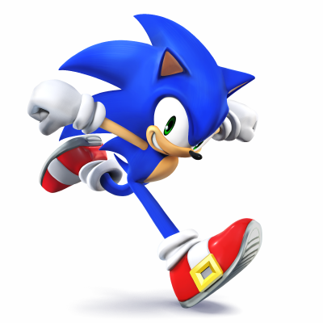
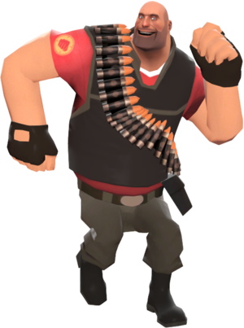
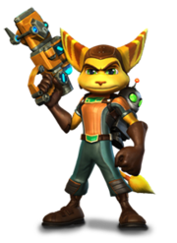
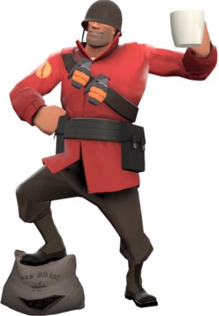
Who is it for?
Males aged 10-15
Fans of mascot-driven games (e.g. Ratchet and Clank, Sonic etc.).
Interested in multiplayer competitive skill-based games (TF2).

Slide 4
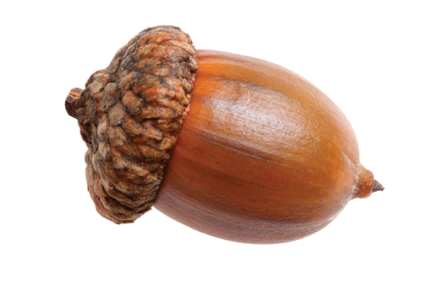
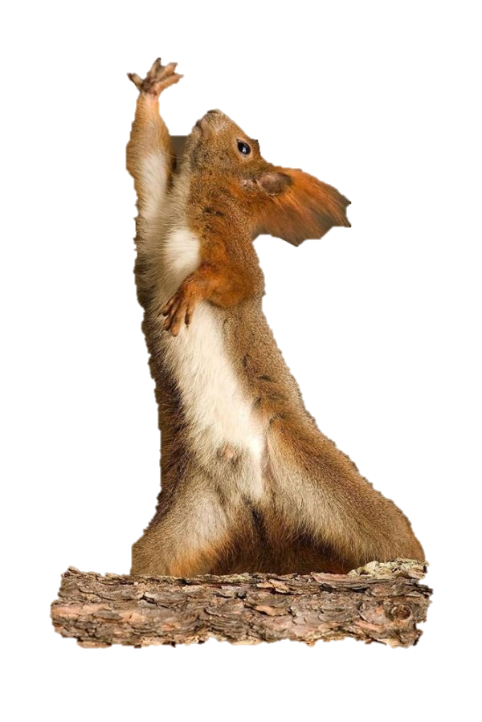
Emotions and Challenges
Tension and release
Fiero
Physical challenges
Twitch
Dexterity
Precision
Mental challenges
Prediction
Strategy
Memorisation
Coordination

Slide 5
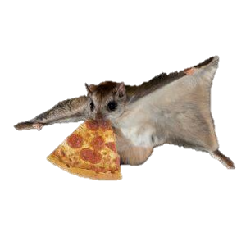
What the players do?
Observe
Streets?
Overall goal:
Obtain 2 nuts before anyone else
Reach the far end of the level
Grab a nut
Return to base
Execute
Decide Path
Decide Method
Rooftops?
Wall jump?
Run?
Grapple?
Notes:
Core game loop:
Observe the level and potential paths through it.
Decide on the optimal path through the map.
Decide the method to achieve that route (ground movement/grapple/glide)
Execute.
Overall goal:
Obtain 3 nuts before anyone else.
Descend the hill
Grab a nut
Return to base

Slide 6
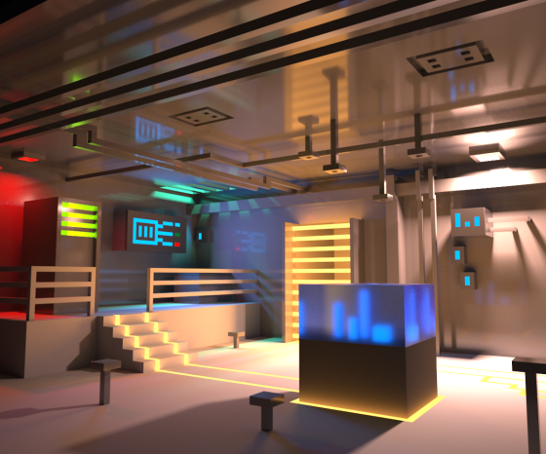
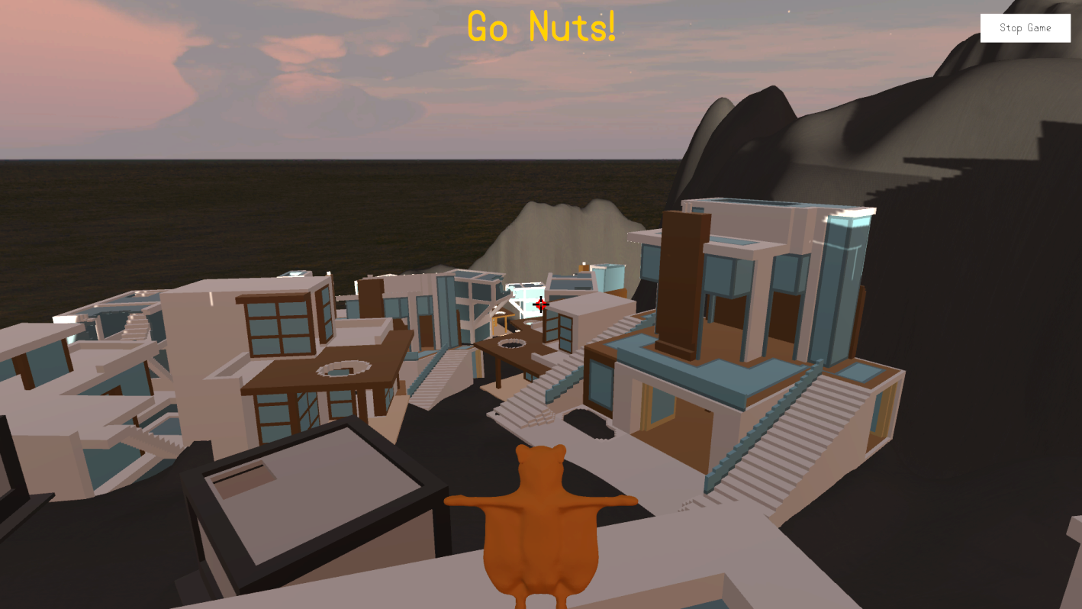


What did it look like?

Slide 7

What’s changed?
Mechanics added (eagle) and adjusted (grapple)
Complete rebuild and iterations of the level
Sounds and music added
All models now in place
Level is fully lit
UI in place
?
?

Slide 8
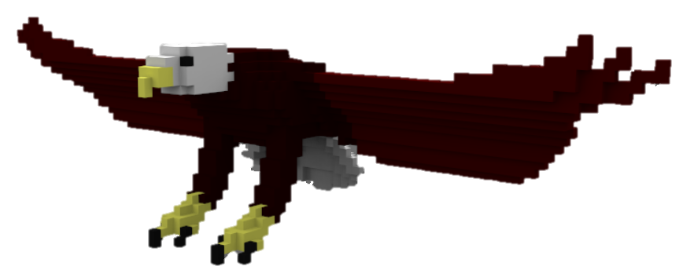
The Eagle
Goals:
To minimise optimal pathing
To increase decision making
Negative feedback
How does it work?:
Being on a roof makes you a target
Further ahead = more likely target
Eagle picks you up and drops you
Players can escape to streets to avoid targeting

Slide 9
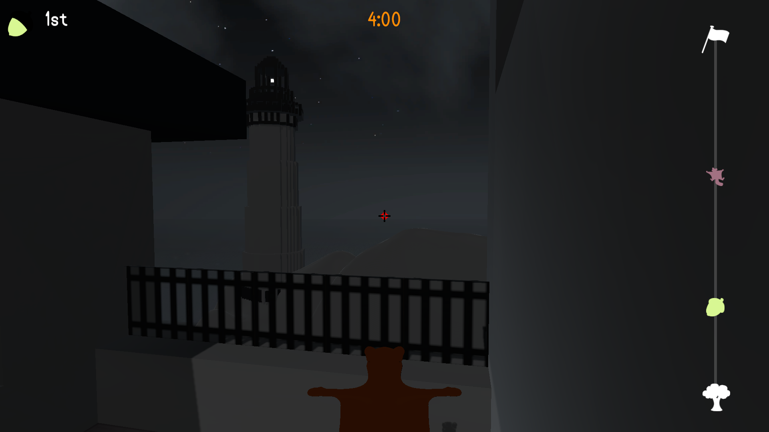
User Interface
Notes:
Radial nut – grapple cooldown
Top left number – race position / nut status
Bar on right – level length and player progress on it
Squirrels on progress bar – players without nut
Nuts on progress bar – players with nut
Timer

Slide 10
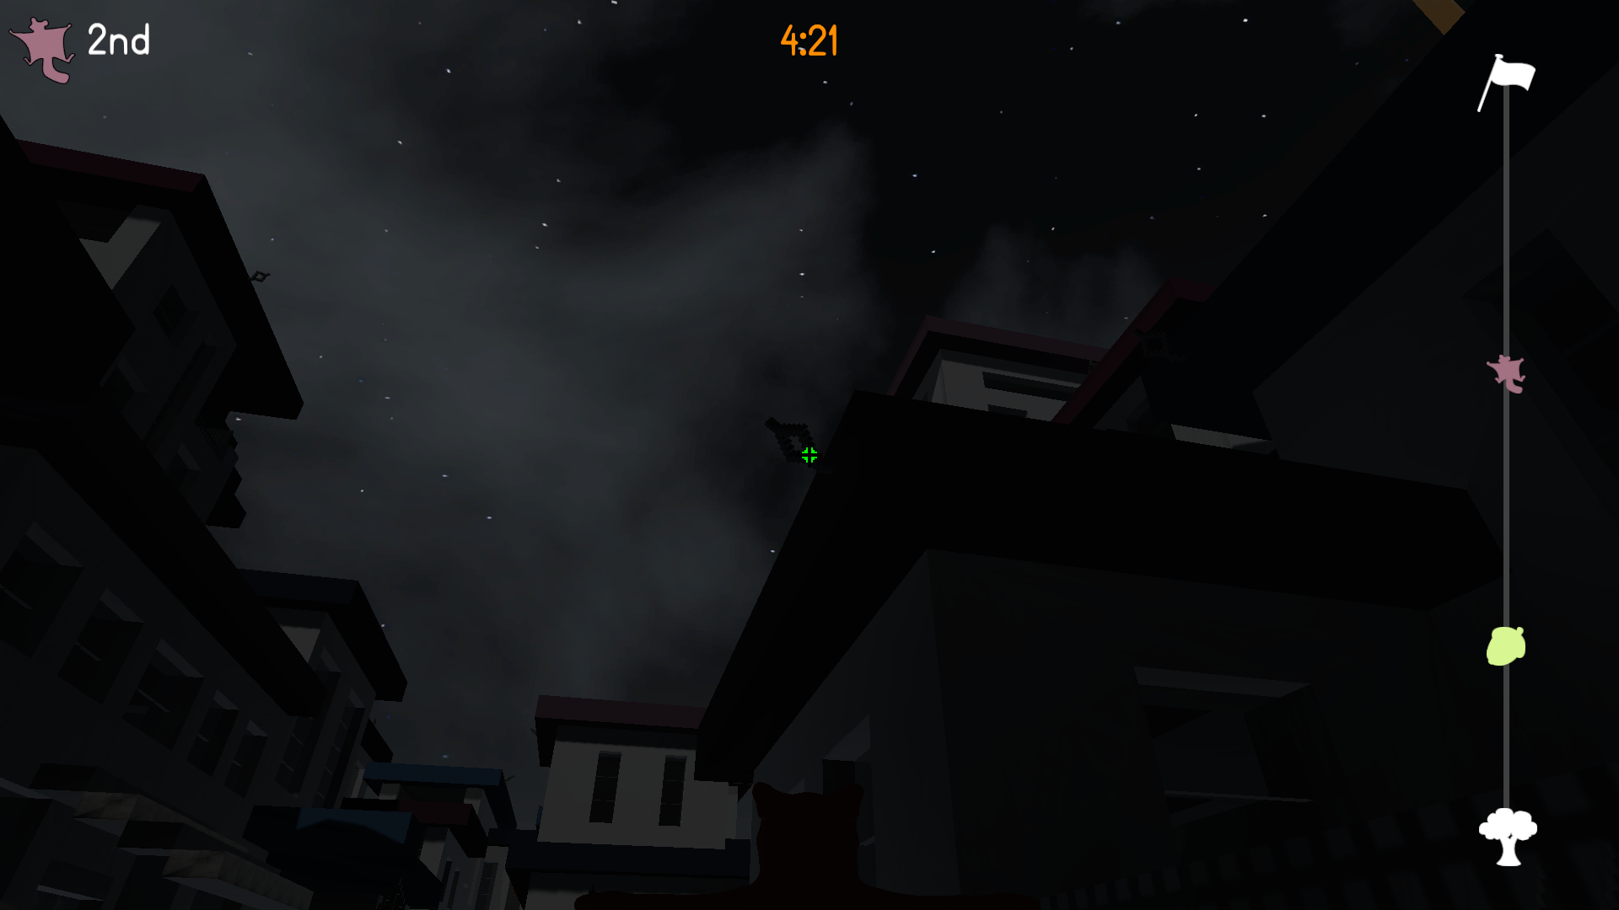
User Interface
Notes:
Radial nut – grapple cooldown
Top left number – race position / nut status
Bar on right – level length and player progress on it
Squirrels on progress bar – players without nut
Nuts on progress bar – players with nut
Timer

Slide 11
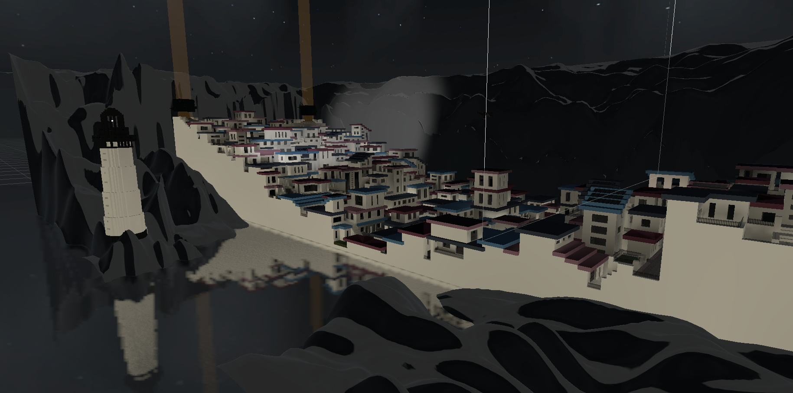
The Level

Slide 12
Gameplay
Click here

Slide 13
Playtesting Feedback
The grappling mechanic was fun
Game was enjoyable overall
Wanted controls shown in the menu
Level is very dark
You can get stuck in the roof of some buildings

Slide 14
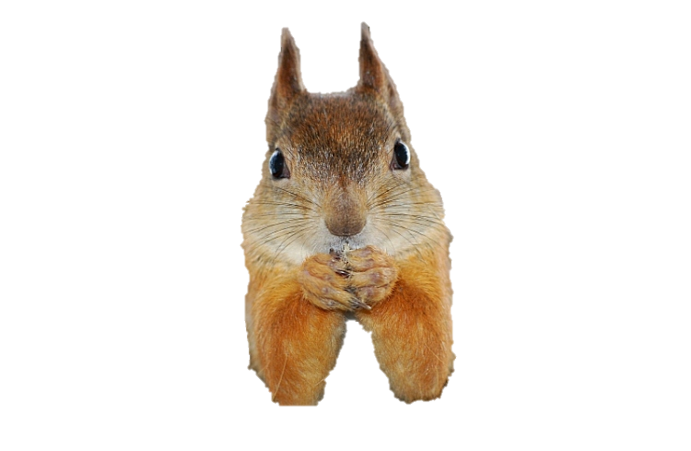
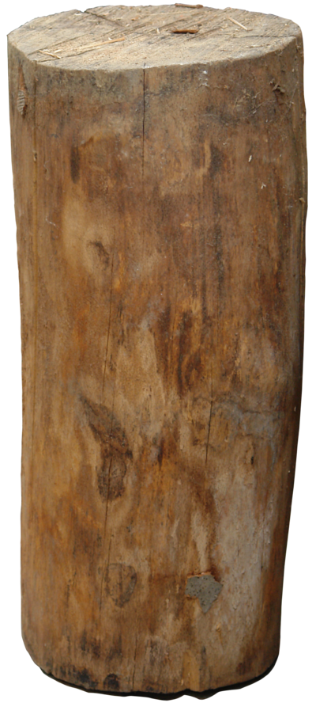
Going forward
Player character model animations
Further playtesting
Polishing mechanics
Polishing UI
Fix lighting issues

Slide 15
Questions?
Elliot Page – Max Carter – Zachari Cooper – Rebecca Brannum – Joe Wilson

